Slide 1
Unit 6
Security and Isolation in Operating Systems

Slide 2
Security-Enhanced Linux (SELinux)
SELinux (Security-Enhanced Linux) is a Mandatory Access Control (MAC) security mechanism integrated into the Linux kernel.
It was developed by the U.S. National Security Agency (NSA) and later integrated into mainstream Linux distributions like Red Hat and Fedora.
Unlike traditional Linux Discretionary Access Control (DAC), where the owner controls permissions, SELinux enforces centrally defined security policies.

Slide 3
SELinux NEED
Traditional Linux security uses:
  User/group ownership
  Read, write, execute permissions
Problem:
  Root user can override everything.
  No fine-grained control over processes.
SELinux solves this using Mandatory Access Control (MAC).

Slide 4
SELinux Core Concepts
1. Mandatory Access Control (MAC)
  Access decisions are enforced by system-wide policies. Even root cannot bypass them.
2. Security Context
  Every process and object has a label:
Components:
  User
  Role
  Type (domain)
  Level (MLS/MCS)
user | role | type | level
system_u | system_r | httpd_t | S0
Staff_u | Staff_r | var_log_t | s1

Slide 5
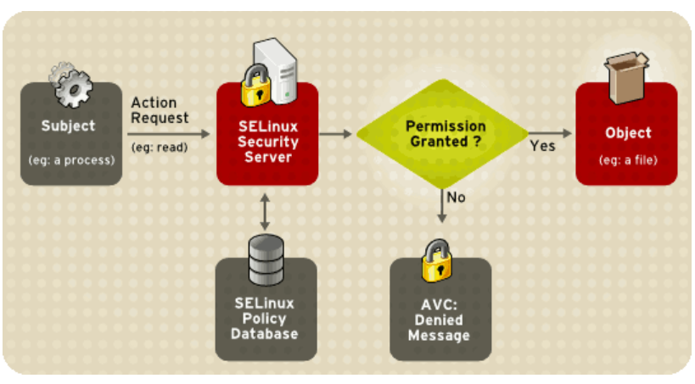
SELinux Architecture
Main components:
Security Server – Enforces security policy
Policy Database – Contains rules
Access Vector Cache (AVC) – Caches decisions for performance
SELinux Hooks in Kernel – Intercepts system calls

Slide 6
SELinux Working
Process requests access to a resource.
Kernel checks SELinux policy.
Policy decision is made.
Access is allowed or denied.
Modes of operation:
  Enforcing → Policy strictly enforced
  Permissive → Violations logged but not blocked
  Disabled → SELinux off

Slide 7
AppArmor
AppArmor (Application Armor) is a Linux Security Module (LSM) that implements Mandatory Access Control (MAC) to restrict program capabilities and limit damage from compromised applications.
It was originally developed by Novell and is widely used in Linux distributions such as:
Ubuntu
SUSE Linux Enterprise
Unlike traditional Linux security which uses Discretionary Access Control (DAC), AppArmor enforces centrally defined security policies.

Slide 8
AppArmor NEED
Traditional Linux permissions are based on:
  User
  Group
  Read/Write/Execute bits
Limitations:
  If an application is compromised, attacker inherits its permissions.
  Root privileges can bypass standard controls.
  No fine-grained per-application restriction.
AppArmor solves this by providing application-level confinement, limiting what each program can access.

Slide 9
AppArmor Core Concept
AppArmor uses security profiles to define restrictions for individual applications.
Each profile specifies:
  File system access
  Network permissions
  Linux capabilities
  Signal permissions
  Inter-process communication (IPC)
Path-Based Access Control
AppArmor is path-based, meaning rules are written using file paths.
  Example: /etc/passwd r,
This differs from Security-Enhanced Linux, which uses label-based access control

Slide 10
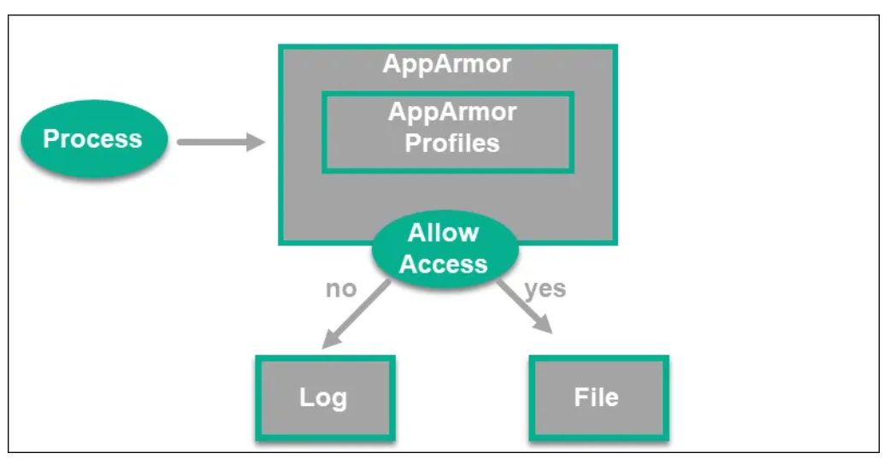
AppArmor Architecture
Kernel Module
Intercepts system calls.
Enforces security rules.
Security Profiles
Stored in: /etc/apparmor.d/
Define restrictions per application.
Userspace Tools
aa-status → Show profile status
aa-enforce → Enable enforce mode
aa-complain → Enable complain mode
aa-disable → Disable profile

Slide 11
AppArmor Working
Application starts execution.
Kernel checks if a profile exists for it.
If profile exists → access is restricted.
If no profile exists → application runs unconfined.
Modes of Operation
Enforce Mode
  Blocks unauthorized actions.
  Logs violations.
Complain Mode
  Allows actions.
  Logs violations for debugging.
Disabled Mode
  AppArmor inactive.

Slide 12
AppArmor: Profile Structure Example
/usr/bin/firefox {
/home/user/** r,
/etc/** r,
/tmp/** rw,
}
Meaning:
  Read access to home directory
  Read access to /etc
  Read & write access to /tmp
  Profiles are human-readable and easier to manage.

Slide 13
AppArmor Features
Path-based access control
Per-application confinement
Learning/complain mode for profile generation
Integration with Linux Security Module framework
Lightweight and efficient

Slide 14
AppArmor Advantages
Easier to configure than SELinux
Human-readable profiles
Lower learning curve
Suitable for desktops and mid-level servers
Effective containment of compromised applications

Slide 15
AppArmor Disadvantages
Path-based control can be bypassed via hard links or renamed paths
Less granular than SELinux
Limited support for MLS (Multi-Level Security)
Not ideal for high-assurance military systems

Slide 16
SELinux vs AppArmor – Comparison
Both Security-Enhanced Linux and AppArmor are Linux Security Modules (LSM) that implement Mandatory Access Control (MAC) to enhance system security beyond traditional Unix permissions.
However, they differ significantly in architecture, complexity, and enforcement model.
SELinux assigns security labels to files and processes.AppArmor uses file path rules to restrict applications.

Slide 17
SELinux vs AppArmor – Comparison
Security Model
SELinux
Uses security context:
user:role:type:level
Based on:
  Type Enforcement (TE)
  Role-Based Access Control (RBAC)
  Multi-Level Security (MLS/MCS)
AppArmor
Uses application-specific profiles.
No label system.
Focused mainly on per-program restriction.

Slide 18
SELinux vs AppArmor – Comparison
Granularity of Control
Aspect | SELinux | AppArmor
Fine-grained control | Very High | Moderate
Process-to-process control | Strong | Limited
MLS support | Full MLS/MCS | Limited
Complexity
Factor | SELinux | AppArmor
Configuration | Complex | Easier
Learning Curve | Steep | Moderate
Debugging | Difficult | Simpler

Slide 19
SELinux vs AppArmor – Comparison
Security Strength
  SELinux → Stronger and more robust security.
  AppArmor → Good protection but less strict.
SELinux is preferred in:
  Enterprise environments
  Government systems
  High-security servers
AppArmor is preferred in:
  Desktop systems
  Small to medium servers
  Ubuntu-based environments

Slide 20
SELinux vs AppArmor – Comparison
Default Distribution Usage
Mode of Operation
Both support:
  Enforcing mode
  Permissive/Complain mode
  Disabled mode
But SELinux policies are more extensive.
Distribution | Default
RHEL, Fedora, CentOS | SELinux
Ubuntu | AppArmor
SUSE | AppArmor

Slide 21
SELinux vs AppArmor – Comparison
Performance
  Both have minimal performance overhead, but SELinux may consume slightly more resources due to deeper policy enforcement.
Security Weakness
  SELinux is Complex to manage, Can break apps if misconfigured.
  AppArmor is Vulnerable to path-based bypass (hard links), Less granular

Slide 22
Isolation Techniques in Linux: Namespaces, Cgroups, and Sandboxing
Isolation techniques are used in operating systems to ensure that processes, users, or applications do not interfere with each other. In Linux, isolation is primarily achieved using:
Namespaces
Control Groups (Cgroups)
Sandboxing
These techniques form the foundation of container technologies like Docker and Kubernetes.

Slide 23
Namespaces
Introduction
Namespaces provide process-level isolation by partitioning kernel resources so that one set of processes sees one view of the system, while another set sees a different view.
In simple words:
Namespaces isolate what a process can see.
Types of Linux Namespaces
1. PID Namespace
Isolates process IDs.
Each namespace has its own PID numbering.
A process can have PID 1 inside a container but a different PID in host.
Used heavily in containers.

Slide 24
Namespaces
2. Mount (mnt) Namespace
Isolates filesystem mount points.
Processes can have different root filesystems.
Used to create container root filesystem.
3. Network Namespace
Provides separate:
  IP addresses
  Routing tables
  Network interfaces
  Firewall rules
Each container can have its own virtual network stack.

Slide 25
Namespaces
4. IPC Namespace
Isolates inter-process communication:
  Shared memory
  Message queues
  Semaphores
5. UTS Namespace
Isolates hostname and domain name.
Each container can have a unique hostname.

Slide 26
Namespaces
6. User Namespace
Maps user IDs inside namespace to different IDs outside.
Allows root inside container without root on host.
Important for security.
Advantages of Namespaces
Lightweight isolation
Foundation of containers
Minimal performance overhead
Strong process separation
Limitation
Does not control resource usage.
Needs Cgroups for resource management.

Slide 27
Control Groups (Cgroups)
Control Groups (Cgroups) limit, account, and isolate resource usage of process groups.
In simple words:
Cgroups control how much a process can use.
Developed by Google and integrated into Linux kernel.
Resources Controlled by Cgroups
CPU usage
Memory usage
Disk I/O
Network bandwidth
Number of processes

Slide 28
Control Groups (Cgroups)
Key Components
Control Group
Subsystems (Controllers)
Hierarchy
Important Controllers
cpu → CPU allocation
memory → Memory limits
blkio → Disk I/O
pids → Limit number of processes
net_cls → Network classification

Slide 29
Control Groups (Cgroups)
Working
Create a cgroup.
Assign resource limits.
Add processes to that group.
Kernel enforces limits.
Example
Limit memory to 512MB:
memory.limit_in_bytes = 536870912

Slide 30
Control Groups (Cgroups)
Advantages
Prevents resource starvation
Ensures fair resource distribution
Essential for container platforms
Supports accounting and monitoring
Limitation
Does not provide visibility isolation (needs namespaces).
Complex hierarchy management (in v1).
Note: Cgroups v2 simplifies design.

Slide 31
Sandboxing
Introduction
Sandboxing is a security technique that runs applications in a restricted environment to prevent them from affecting the rest of the system.
It isolates applications from:
File system
Network
System calls
Hardware access

Slide 32
Sandboxing
Types of Sandboxing in Linux
1. Seccomp (Secure Computing Mode)
Restricts system calls a process can make.
Used in:
Containers
Browsers
Example:
Allow only read, write, exit syscalls.

Slide 33
Sandboxing
2. AppArmor / SELinux
Mandatory Access Control-based sandboxing.
Security-Enhanced Linux
AppArmor
They confine application behavior.
3. chroot Jail
Changes root directory for a process.
But weak compared to namespaces.

Slide 34
Sandboxing
4. Browser Sandboxing
Used in:
Chrome
Firefox
Prevents malicious web code from accessing OS.

Slide 35
Sandboxing
Advantages of Sandboxing
Contains malware damage
Reduces attack surface
Protects system integrity
Enhances application-level security
Limitations
Misconfiguration reduces effectiveness
Some performance overhead
Not complete virtualization

Slide 36
Address Space Layout Randomization (ASLR) and Stack Protection
Modern operating systems implement memory protection techniques to prevent exploitation of vulnerabilities such as buffer overflow attacks. Two important protection mechanisms are:
Address Space Layout Randomization (ASLR)
Stack Protection (Stack Canaries / Stack Smashing Protection)

Slide 37
Address Space Layout Randomization (ASLR)
Introduction
Address Space Layout Randomization (ASLR) is a memory protection technique that randomizes the memory addresses used by system and application processes.
It prevents attackers from predicting the location of:
Stack
Heap
Shared libraries
Executable code
ASLR makes memory exploitation significantly harder.

Slide 38
Address Space Layout Randomization (ASLR)
Why ASLR is Needed
In classic buffer overflow attacks:
Attacker injects malicious code.
Overwrites return address.
Redirects execution to known memory address.
Without ASLR:
Memory layout is predictable.
Exploit becomes easy.
With ASLR:
Memory addresses change each execution.
Attacker cannot predict target address.

Slide 39
Address Space Layout Randomization (ASLR)
What ASLR Randomizes
Stack base address
Heap base address
mmap region
Shared libraries
Executable base (if PIE enabled)

Slide 40
Address Space Layout Randomization (ASLR)
Working Mechanism
When a program starts:
Kernel loads program into memory.
Memory regions are assigned random offsets.
Each execution gets a different layout.
Example:
Run 1:
libc → 0x7f34a12000
Run 2:
libc → 0x6a91b34000
Different address every time.

Slide 41
Address Space Layout Randomization (ASLR)
Types of ASLR
Partial ASLR
  Randomizes stack and libraries only.
Full ASLR
  Randomizes stack, heap, mmap, and executable.
PIE (Position Independent Executable)
  Required for full randomization of main program.

Slide 42
Address Space Layout Randomization (ASLR)
Advantages
Prevents Return-to-libc attacks
Mitigates buffer overflow exploitation
Increases attack complexity
Lightweight protection
Limitations
Does not fix vulnerability itself
Can be bypassed using:
  Information leaks
  Brute force
Less effective in 32-bit systems (limited address space)

Slide 43
Stack Protection (Stack Smashing Protection)
Introduction
Stack protection mechanisms prevent stack-based buffer overflow attacks by detecting unauthorized modification of return addresses.
Common implementation:
Stack Canaries
Stack Smashing Protection (SSP)
What is Stack Overflow?
When:
Program writes beyond buffer size.
Overwrites adjacent memory.
May overwrite return address.
Example:
char buffer[10]; gets(buffer); // unsafe
If input > 10 characters → overflow.

Slide 44
Stack Protection (Stack Smashing Protection)
Stack Canary Concept
A canary value is placed between:
Local variables ↓ Canary ↓ Return Address
Before function returns:
Program checks if canary value changed.
If modified → program terminates.
Why Called “Canary”?
Like a coal mine canary:
If it dies → danger detected.
If canary value changes → attack detected.

Slide 45
Stack Protection (Stack Smashing Protection)
Types of Stack Canaries
Terminator Canary
  Uses special characters (null, newline, etc.)
Random Canary
  Random value generated at runtime.
XOR Canary
  Combines random value with control data.
Working Mechanism
Function call.
Canary inserted into stack.
Buffer overflow occurs.
Canary gets overwritten.
Before returning:
if (canary != original_value) abort();
Program terminates.

Slide 46
Stack Protection (Stack Smashing Protection)
Advantages
Detects stack buffer overflow
Low overhead
Prevents return address corruption
Integrated in modern compilers (GCC with -fstack-protector)
Limitations
Protects only stack-based overflow
Cannot stop heap overflow
If attacker knows canary value → bypass possible

Slide 47
Mitigation Techniques for Side-Channel Attacks
A side-channel attack is a type of security attack that exploits indirect information leakage from a system rather than weaknesses in cryptographic algorithms themselves.
Instead of breaking encryption mathematically, attackers analyze:
Execution time
Power consumption
Electromagnetic radiation
Cache behavior
Acoustic signals
These attacks are especially dangerous in:
Cryptographic systems
Smart cards
Embedded devices
Cloud computing environments

Slide 48
Mitigation Techniques for Side-Channel Attacks
Common Types of Side-Channel Attacks
Timing Attacks
Power Analysis Attacks
Electromagnetic (EM) Attacks
Cache Attacks
Speculative Execution Attacks (e.g., Spectre, Meltdown)

Slide 49
Mitigation Techniques for Side-Channel Attacks
Mitigation Techniques
Side-channel mitigation can be implemented at multiple levels:
Algorithm level
Software level
Hardware level
System level

Slide 50
Mitigation Techniques for Side-Channel Attacks
Constant-Time Algorithms
Problem:
Timing variations reveal secret information.
Solution:
Use constant-time implementations.
Example:
Instead of:
if (key_bit == 1) do_operation();
Use:
Branch-free logic
Same execution path regardless of key value
This prevents timing leakage.

Slide 51
Mitigation Techniques for Side-Channel Attacks
Masking Techniques
Concept:
Randomize intermediate values during computation.
Instead of computing:
C = f(secret_key)
Compute:
C = f(secret_key ⊕ random_mask)
Even if attacker measures power or EM signals, the secret remains hidden.
Used widely in:
Smart cards
Hardware cryptographic modules

Slide 52
Mitigation Techniques for Side-Channel Attacks
Blinding Techniques
Used especially in RSA.
Before encryption/decryption:
Multiply input by random number.
Remove randomization after computation.
This prevents attackers from correlating power or timing patterns.

Slide 53
Mitigation Techniques for Side-Channel Attacks
Cache Attack Mitigation
Cache-based side-channel attacks occur in shared environments like cloud systems.
Techniques:
a) Cache Partitioning
Separate cache regions for different processes.
b) Flush-on-Context-Switch
Clear cache when switching processes.
c) Disable Shared Memory
Prevent cross-VM leakage.
d) Constant Memory Access Pattern
Avoid secret-dependent memory access.

Slide 54
Mitigation Techniques for Side-Channel Attacks
Noise Injection
Introduce artificial randomness:
Add random delays
Random dummy operations
Random power noise
Makes signal analysis difficult.
Limitation:
Too much noise reduces performance.

Slide 55
Mitigation Techniques for Side-Channel Attacks
Hardware-Level Countermeasures
a) Shielding
Protect against EM leakage.
b) Power Line Filtering
Prevent power analysis.
c) Secure Enclaves
Example:
Intel SGX
Isolate sensitive computation.

Slide 56
Mitigation Techniques for Side-Channel Attacks
Speculative Execution Mitigation
For vulnerabilities like Spectre and Meltdown:
Disable branch prediction features
Kernel page table isolation (KPTI)
Microcode updates
Retpoline technique
These prevent speculative execution from leaking data.

Slide 57
Mitigation Techniques for Side-Channel Attacks
Operating System Level Mitigation
Isolate processes using namespaces
Disable simultaneous multithreading (SMT)
Restrict shared hardware resources
Apply security patches regularly
Cryptographic Best Practices
Use well-tested libraries
Avoid custom crypto implementations
Keep keys in hardware security modules (HSMs)
Use side-channel resistant algorithms

Slide 58
Case Studies:(15 MARKS)
Linux Security Module,
Android Security Architecture
macOS Security Architecture)

